Slide 1
Dolby Intrinsics SIMDLib Training
January 2017
Richard Han

Slide 2
Outline
What is SIMD?
What is SIMDLib?
Values
Basics
Datatype
Operators
Special Usage

Slide 3
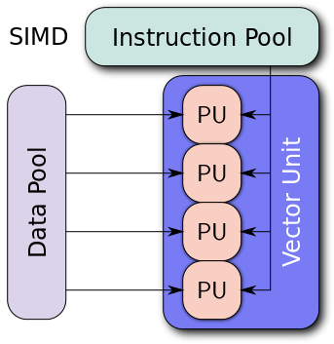
What is SIMD?
SIMD
Single Instruction Multiple Data
Availability
NEON in ARM
SSE/AVX in x86
QDSP
HiFi
…

Slide 4
What is SIMDLib?
An abstraction of SIMD instructions in Dolby Intrinsics
Falls back to scalar low level Intrinsics operators for non-SIMD backends

Slide 5
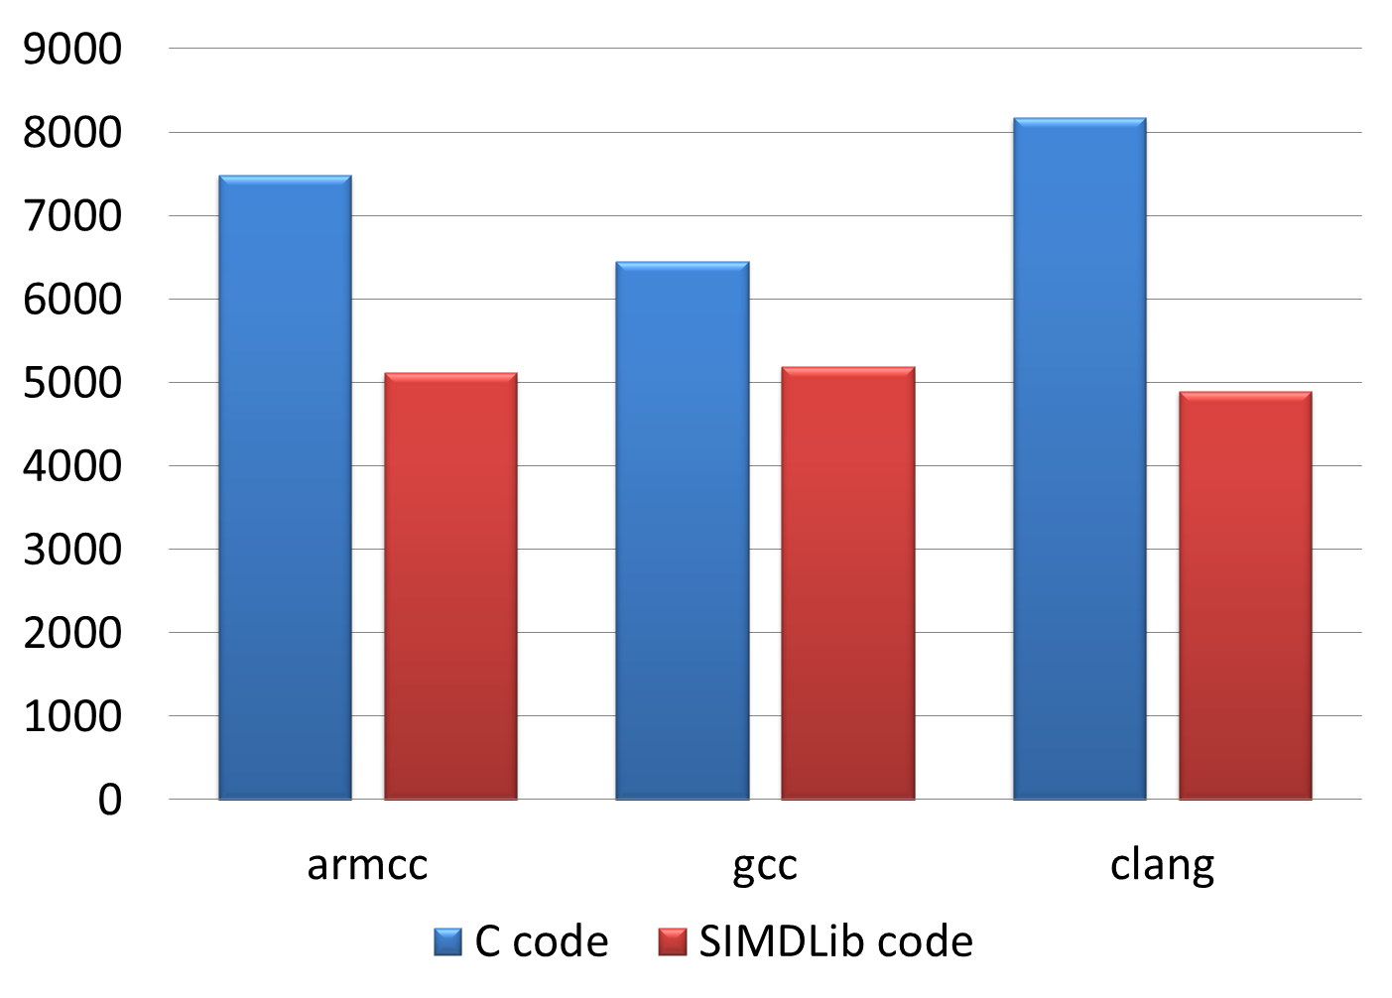
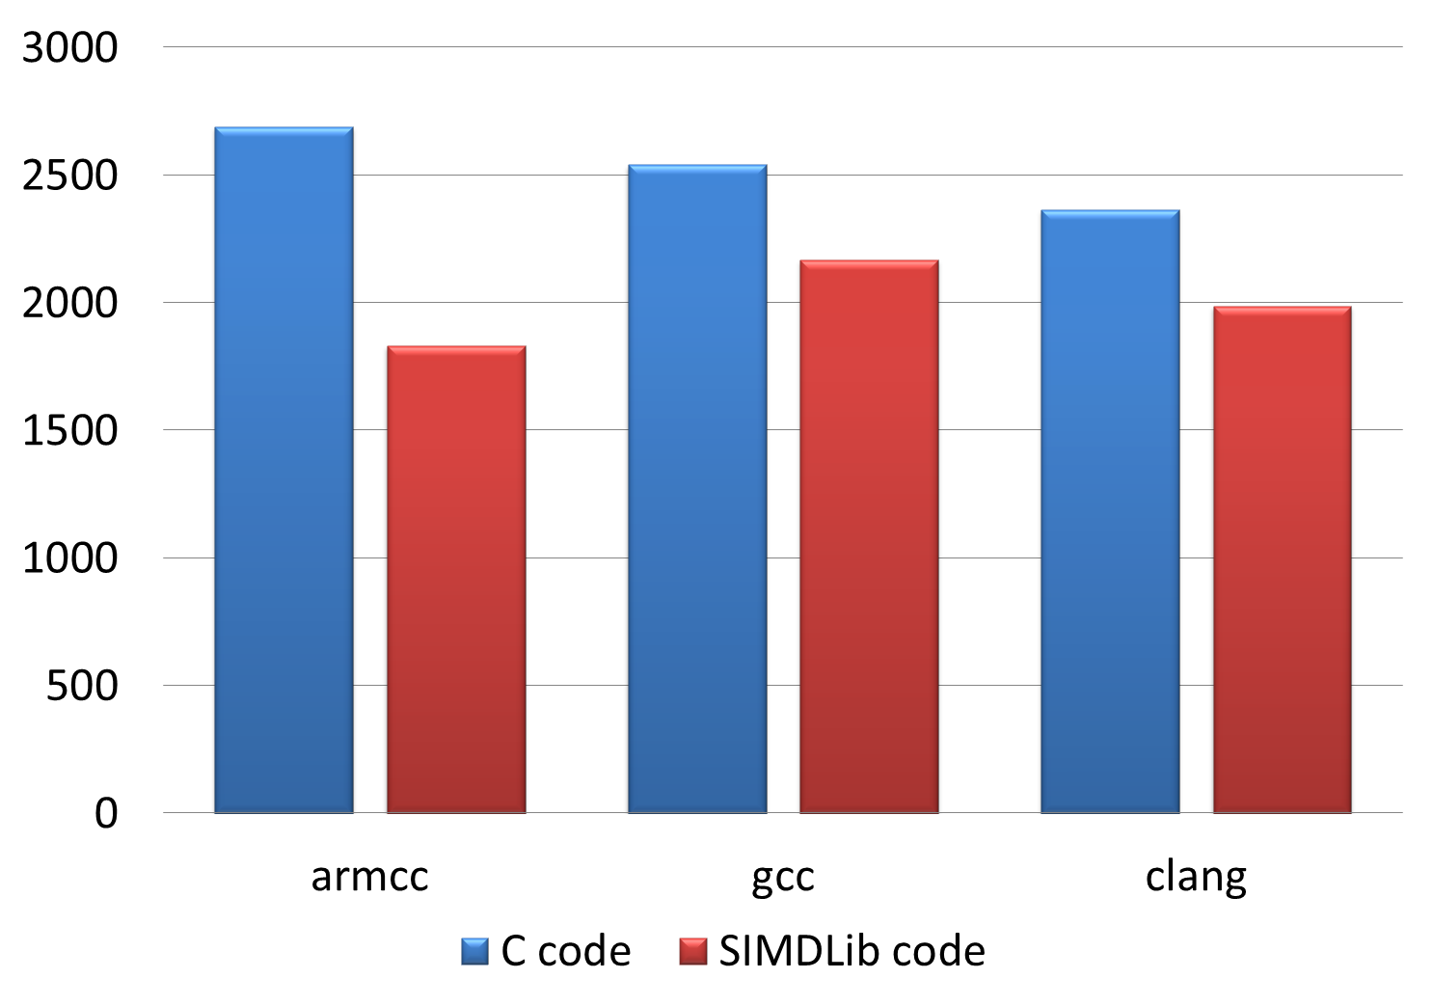
Value - Complexity
Scaled 64-point floating-point complex FFT on armv7hf (Pandaboard)
64-band floating-point CQMF analysis on armv7hf (Pandaboard)
Cycles
Cycles

Slide 6
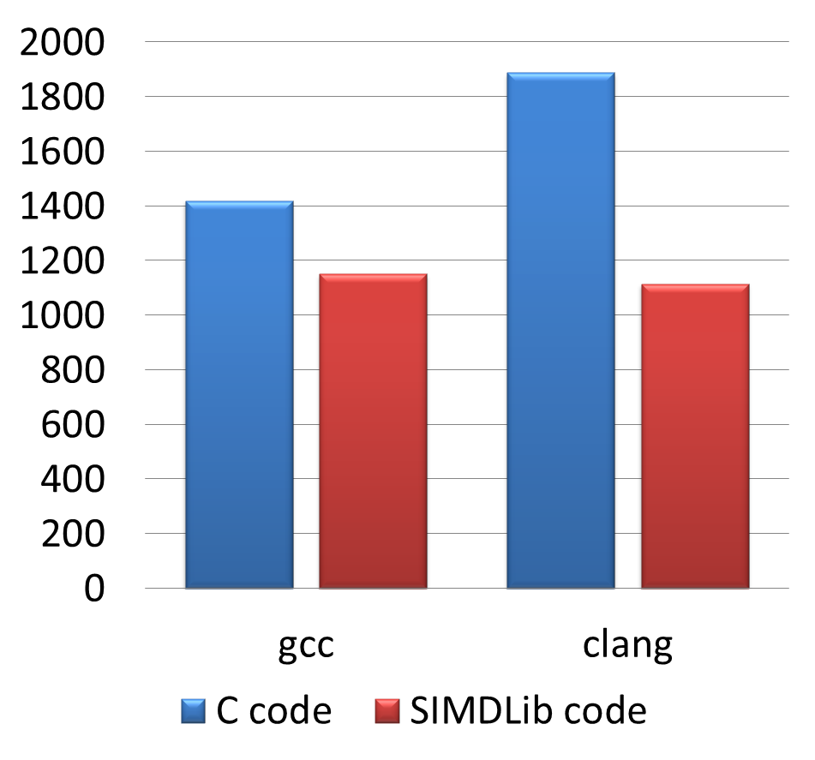
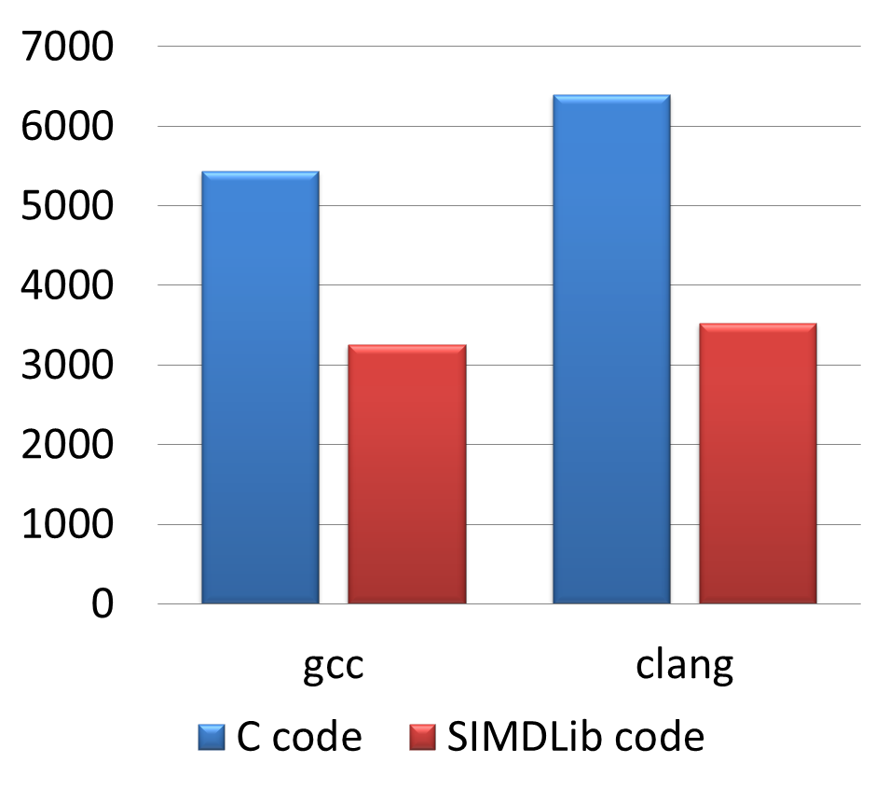
Value - Complexity
Scaled 64-point floating-point complex FFT on armv8 (Dragonboard)
64-band floating-point CQMF analysis on armv8 (Dragonboard)
Cycles
Cycles

Slide 7
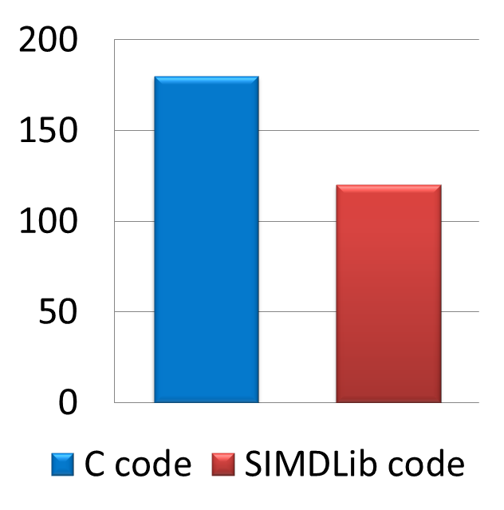
Value - Complexity
Cicero – Capture project on armv8 with gcc (Dragonboard)
MCPS

Slide 8
Value – Porting Effort
Targeting five different targets at once
Targeting non-existing licensee targets
ARMv7 Floating-Point NEON
Man days
ARMv7 Fixed-Point NEON
ARMv8 Floating-Point NEON
?
SIMDLib
Scalar Code
X86/X64 SSE

Slide 9
Basics for SIMDLib
The length of SIMD vector - DLB_VEC_N
Use DLB_VEC_N in loop end condition instead of arbitrary number
Some trade-off between commonality and performance

Slide 10
Datatype
DLB_LVEC (V)
A vector of DLB_VEC_N of DLB_LFRACT
DLB_WVEC (W)
A vector of DLB_VEC_N of DLB_WFRACT
DLB_AVEC (vA)
A vector of DLB_VEC_N of DLB_ACCU
DLB_OSHLVEC (vO)
A vector of DLB_VEC_N of DLB_OSHL.
DLB_OSHRVEC (vO)
A vector of DLB_VEC_N of DLB_OSHR
Scalar Datatype in SIMDLib operators
DLB_LFRACT (L)
DLB_WFRACT (w)
DLB_OSHL (O)
DLB_OSHR (O)
unsigned (U)

Slide 11
Operators
Add/Subtract
DLB_VaddVV, DLB_VsubVV, …
DLB_vAaddvAvA, DLB_vAsubvAvA, …
Multiply/Multiply-Accumulate
DLB_VmacVVV, DLB_VmacVVW, …
DLB_vAmacvAVW, …
Shift
DLB_VshLVU, DLB_VshrVO, …
DLB_vAshrvAO, …
Logic
DLB_VmaxVV, DLB_VmaxVL, …
Headroom
DLB_VheadVvO, …
Reduction
DLB_LaddV, …
Load/Store
DLB_Vld_vec_L, DLB_VVld_unzip_vec_L
DLB_WWld_vec_S, …

Slide 12
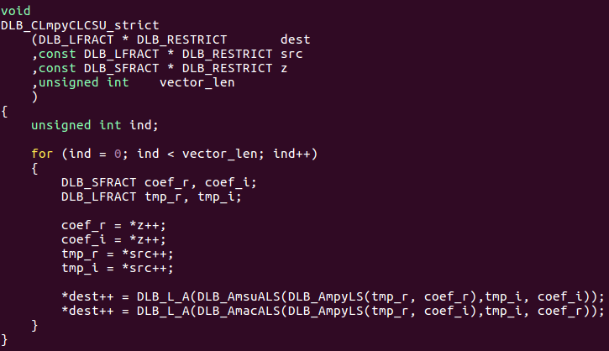
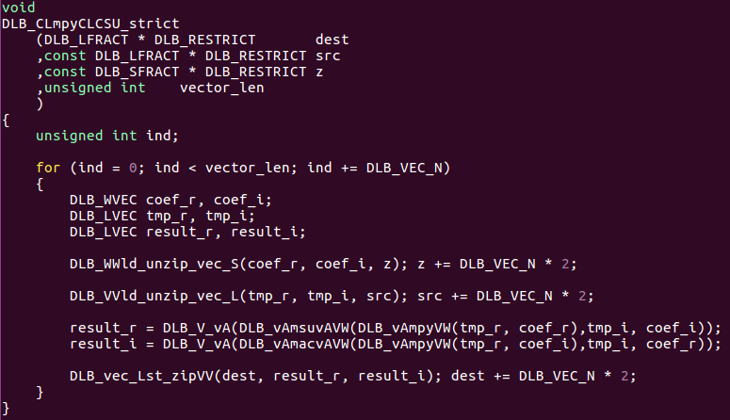
Example
Notes:
Interleave/deinterleave equals to zip/unzip

Slide 13
SIMDLib differences from scalar DI
Load/Store
Scalar DI lets the C language and compiler load and store values as needed
SIMDLib requires explicit load/store operators
Aligned/unaligned
Initialization
DLB_VsplatL(DLB_L00)

Slide 14
Special Usage
Default value of DLB_VEC_N is 4 for current SIMD supported backends
Fixed/Float NEON, SSE
It can be configured per each C file
DLB_SIMD_USE_SCALAR: Use scalar version.
DLB_SIMD_USE_VEC2: Use SIMD implementations with vector length as 2.
DLB_SIMD_USE_VEC4: Use SIMD implementations with vector length as 4.
Debug functionality
DLB_SIMD_DEBUG_VEC2: Vector length is 2. Use implementations in dlb_simdlib_generic2.h
DLB_SIMD_DEBUG_VEC4: Vector length is 4. Use implementations in dlb_simdlib_generic4.h

Slide 15
When do we use SIMDLib?
Complexity intensive part
Not *very* simple loop

Slide 16
Future
Vector length 8 support
E.g. AVX
More operators based on feedback

Slide 17
Further Information
Dolby Intrinsics Implementation Manual
OotBoP - Writing code with awesome out of the box performance

Slide 18
Goal
SIMDLib – Make a SIMple Day for us

